Slide 1
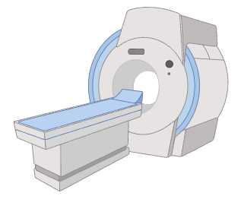
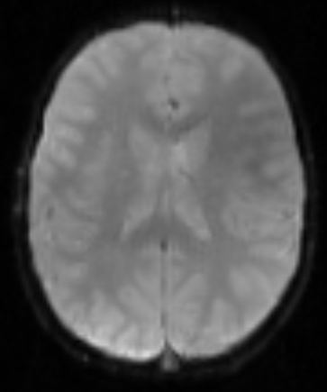
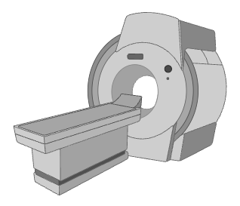
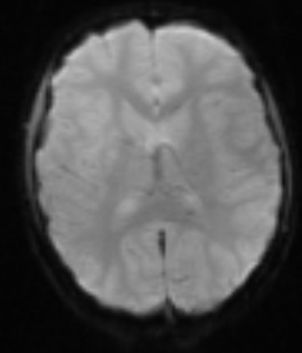
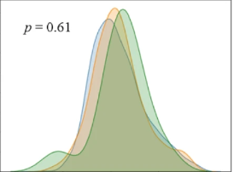

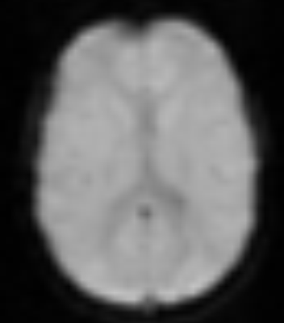


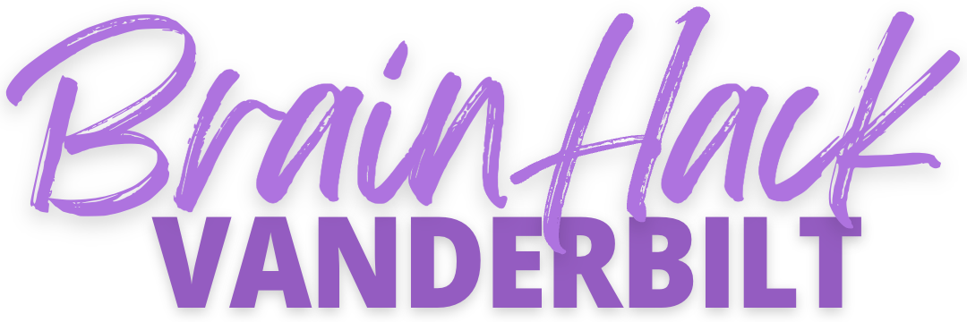
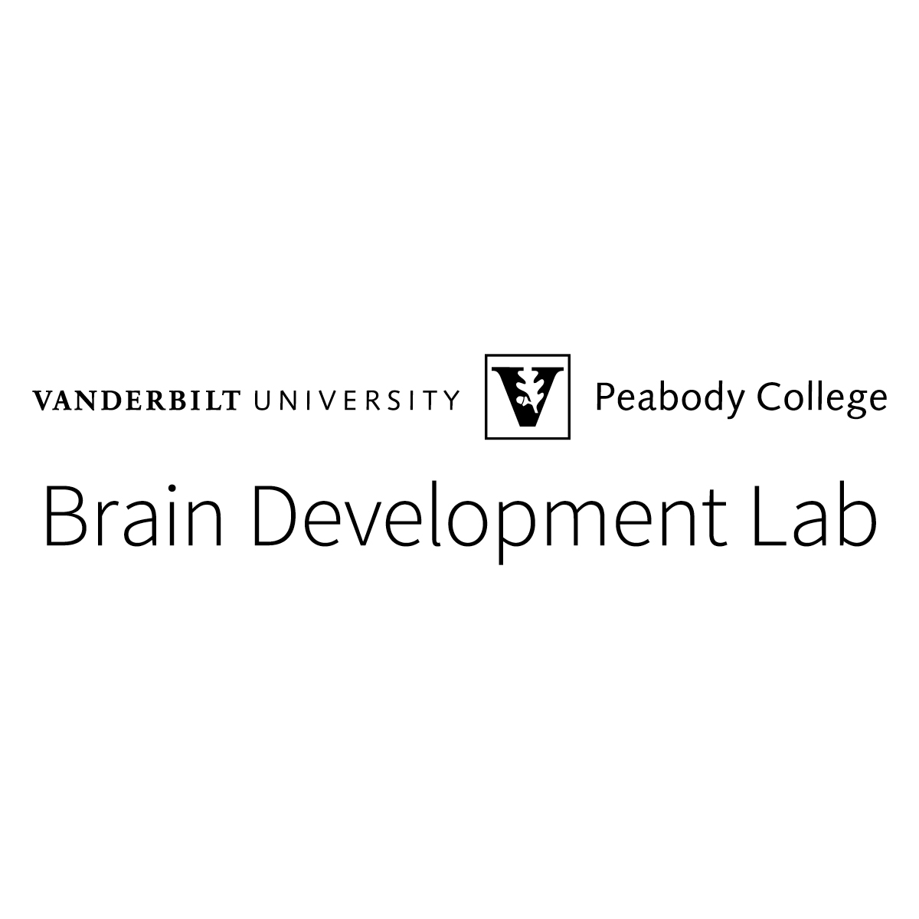
Does Nonverbal IQ Modulate the Relation Between Phonological Awareness and Reading Skill? Harmonization of Multi-Site fMRI-data
Discord channel # fMRI_harmonization
Isaac Chen & James R. Booth
Our Motivation
Reading skill (i.e. ability to read single words aloud) and phonological awareness (i.e. sensitivity to sound structure of language) are bi-directionally related, but the role of nonverbal IQ in this relationship is unclear.
Our Goal
Develop a harmonization pipeline using ComBat for task-based fMRI data in children to reliably remove between-scanner variability.
Snapshot of What We Will Do:
Go through a simple ComBat tutorial.
Run ComBat on our sample data.
Evaluate effectiveness of harmonization and how motion affects it.
Site #1
Site #2
Harmonization
Site #3
GitHub

